Slide 1
FIR/Complaint Classification and Priority Prediction System
PRESENTED BY : Maaz PATEL
IMARTICUS LEARNING
BATCH : PGA 41

Slide 2

Problem Statement
A large number of complaints are received daily by the organizations and authorities.
Manual review and sorting of complaints is time-consuming.
Identifying the correct complaint category manually can lead to errors.
Urgent complaints may be delayed due to lack of priority detection.
An automated NLP – based system is needed for faster and accurate complaint handling.
GOAL : Build an intelligent complaint management system for accurate classification and timely action.
This Photo by Unknown Author is licensed under CC BY-SA

Slide 3
Objectives
Automate complaint classification using NLP.
Perform Exploratory Data Analysis (EDA)
Predict complaint categories accurately.
Identify urgent complaints by priority level.
Evaluate multiple ML models.
Tune the model
Improve processing speed and efficiency.
Deploy a user-friendly web application.

Slide 4

Dataset Information
Dataset Source: Kaggle
File Name: complaints_processed.csv
Total Records: 162,421 complaint entries
Total Columns: 3
Input Feature: Complaint Narrative Text
Target Variable: Product / Complaint Category
Dataset contains multiple complaint categories for classification.

Slide 5
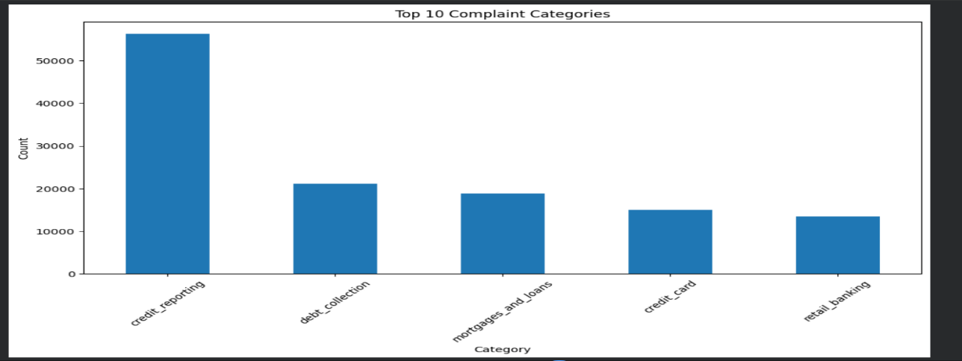
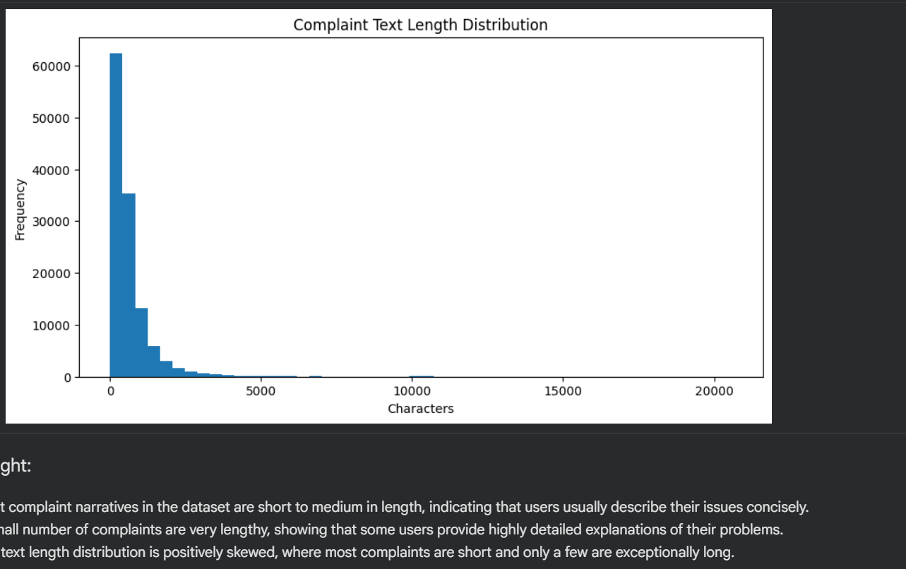
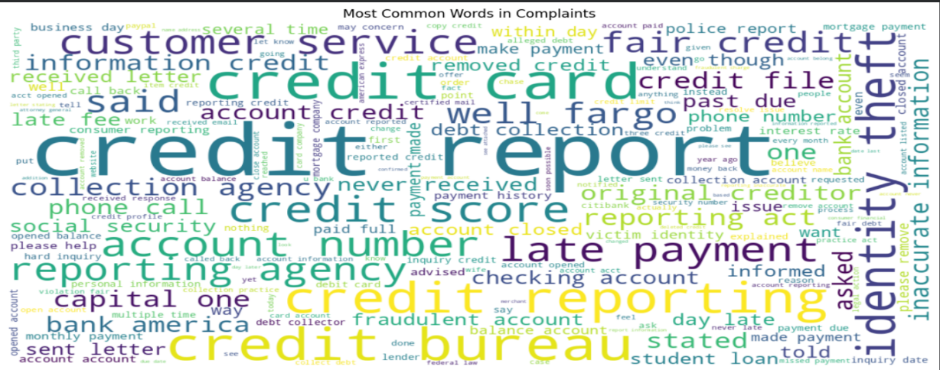
Exploratory Data Analysis (EDA)
Insights:
1. The category 'credit reporting' has the highest number of complaints in the dataset, indicating that many users face issues related to credit reports, credit scores, or incorrect financial reporting records.
2. First, we created a column "text length" in which we have calculated the text length of each row.
Most complaint narratives in the dataset are short to medium in length, indicating that users usually describe their issues concisely. A small number of complaints are very lengthy, showing that some users provide highly detailed explanations of their problems. The text length distribution is positively skewed, where most complaints are short and only a few are exceptionally long.
3. Large words like credit card, credit report, credit score, fair credit, scores indicates that many complaints are about the credit cards itself.

Slide 6
Models Built & Evaluated
Models Build | Accuracy
Logistic Regression | 0.85
Naive Bayes | 0.81
Decision Tree | 0.77
Among all evaluated models, Logistic Regression delivered the best performance with highest prediction accuracy.

Slide 7
Model Optimization using Grid Search CV
Hyperparameter tuning was applied to improve Logistic Regression performance.
GridSearchCV was used to test multiple parameter combinations.
Parameters such as C, solver, and max_iter were optimized.
Best model was selected using cross-validation score.
Parameter | Best Value
C | 1
Solver | Ibfgs
max_iter | 1000

Slide 8
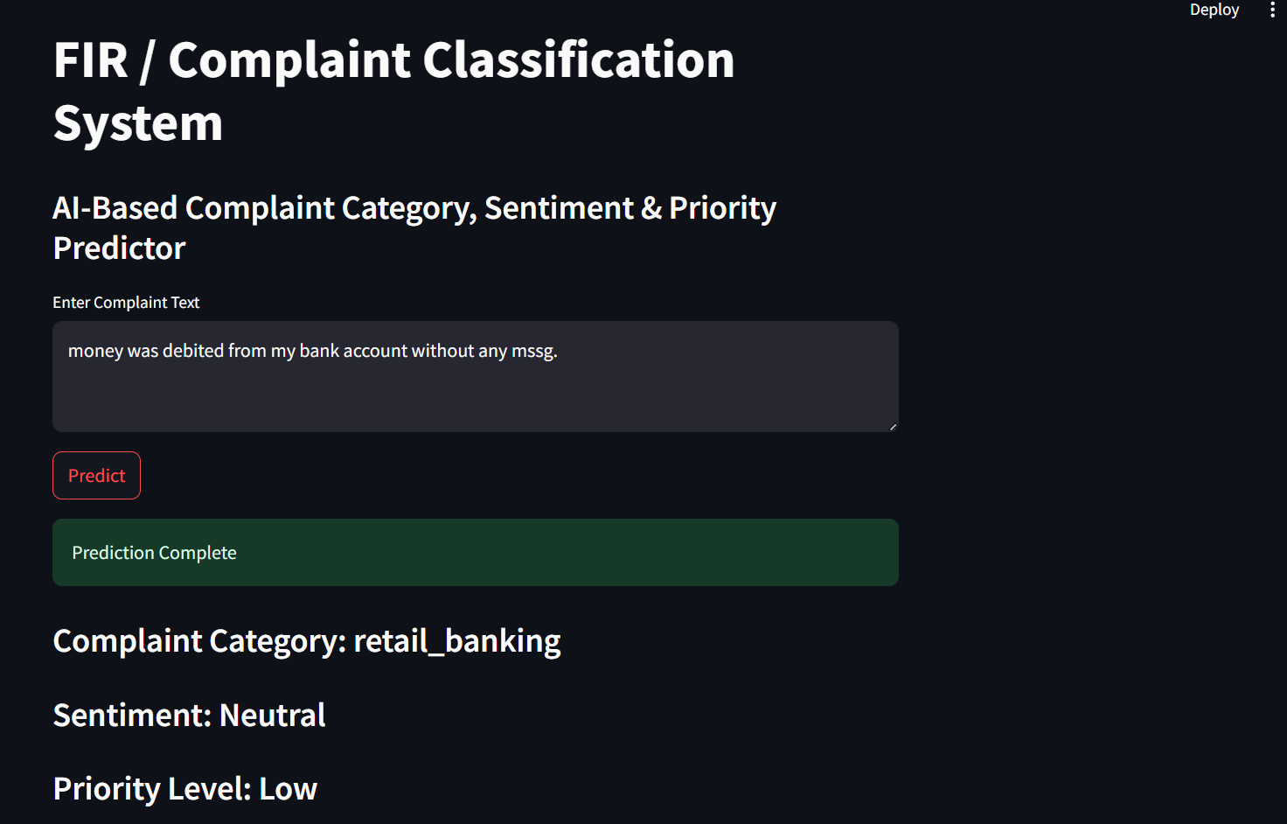
Model Deployment using Streamlit
Developed an interactive web application using Streamlit.
Users can enter complaint text in the input box.
System predicts complaint category instantly and displays the priority level (High/Medium/Low).
Shows sentiment analysis result.
User-friendly interface for real time usage.

Slide 9
Conclusion
Successfully developed an NLP- based complaint classification model.
Compared multiple machine learning models.
Logistic Regression achieved the best performance.
Deployed the model using Streamlit for real time use.
System helps automate complaint handling and priority detection.

Slide 10
Future Scope:
In the future, this project can be enhanced by using real-time complaint datasets for more accurate predictions. Multilingual support can be added to process complaints in languages such as Hindi and Marathi. Voice-to-text functionality can make complaint registration easier for users. Advanced deep learning models such as BERT and LSTM can be implemented to improve performance. The system can also be integrated with police or customer support dashboards for real-time monitoring and faster response.

Slide 11
Thank You! Any Questions?

